Slide 1

CJAM
CLOVER
Spring/Summer 2021
1/3
Jennifer Sweatman, Michelle Olvera, Allison C Dibble, Clarissa Navarrete
MDSE 3250 Final Project: Mini-Product Line

Slide 2
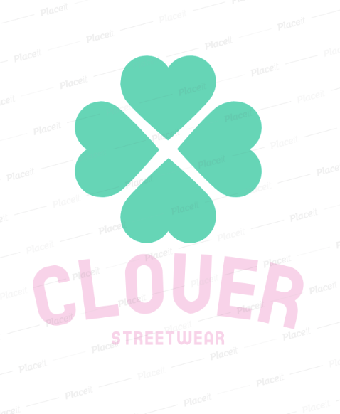

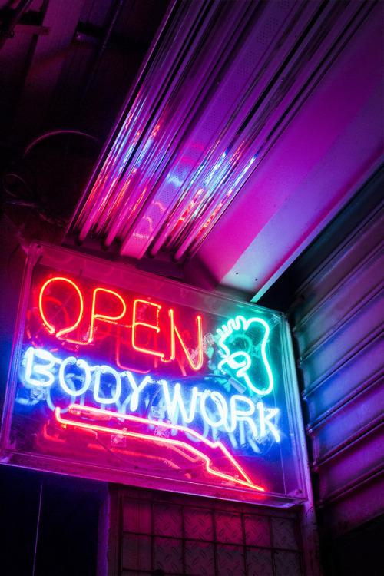
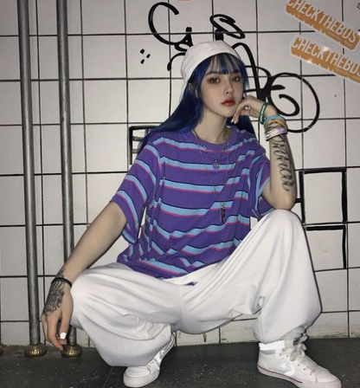
BUSINESS PLAN
CJAMM, “Clover”
Streetwear has been a huge trend, and many retailers have honed in on this idea of utility inspired, dark, bright, and edgy streetwear style. We want to bring in a whole line dedicated to light, soft, and girly streetwear that is size inclusive.
Women's apparel, sizes XS--5XL
S/S 21, March 3rd
Moderate Price Point Category: $30-$80
Casual Lifestyle Apparel
Modified Cycle Time, 12-16 Weeks
Target Market
  Women, 18-30 yrs, trendy, fast-paced lifestyle,
urban areas, upbeat, young adults with disposable income. Gen Z
Notes:
In the last couple of years, the streetwear trend has skyrocketed into mainstream media. With the comfort and personality trend movements in full swing, young women all around the world have resonated with the empowering streetwear style. “Clover” aims to be size inclusive, affordable, and empowering!
TARGET: Trendy young women ages 16 to 26 that live a fast-paced lifestyle, and have a disposable income. These individuals generally make around $10k to $45K a year, and are in highschool, college, or even starting their careers.

Slide 3

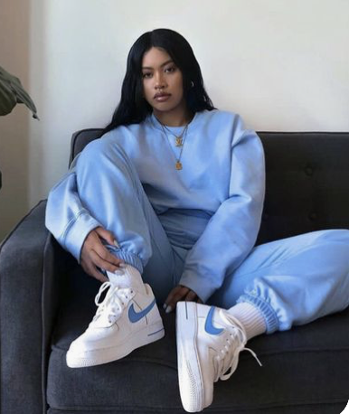
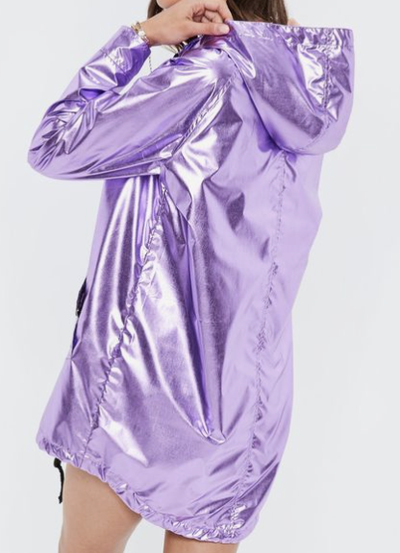
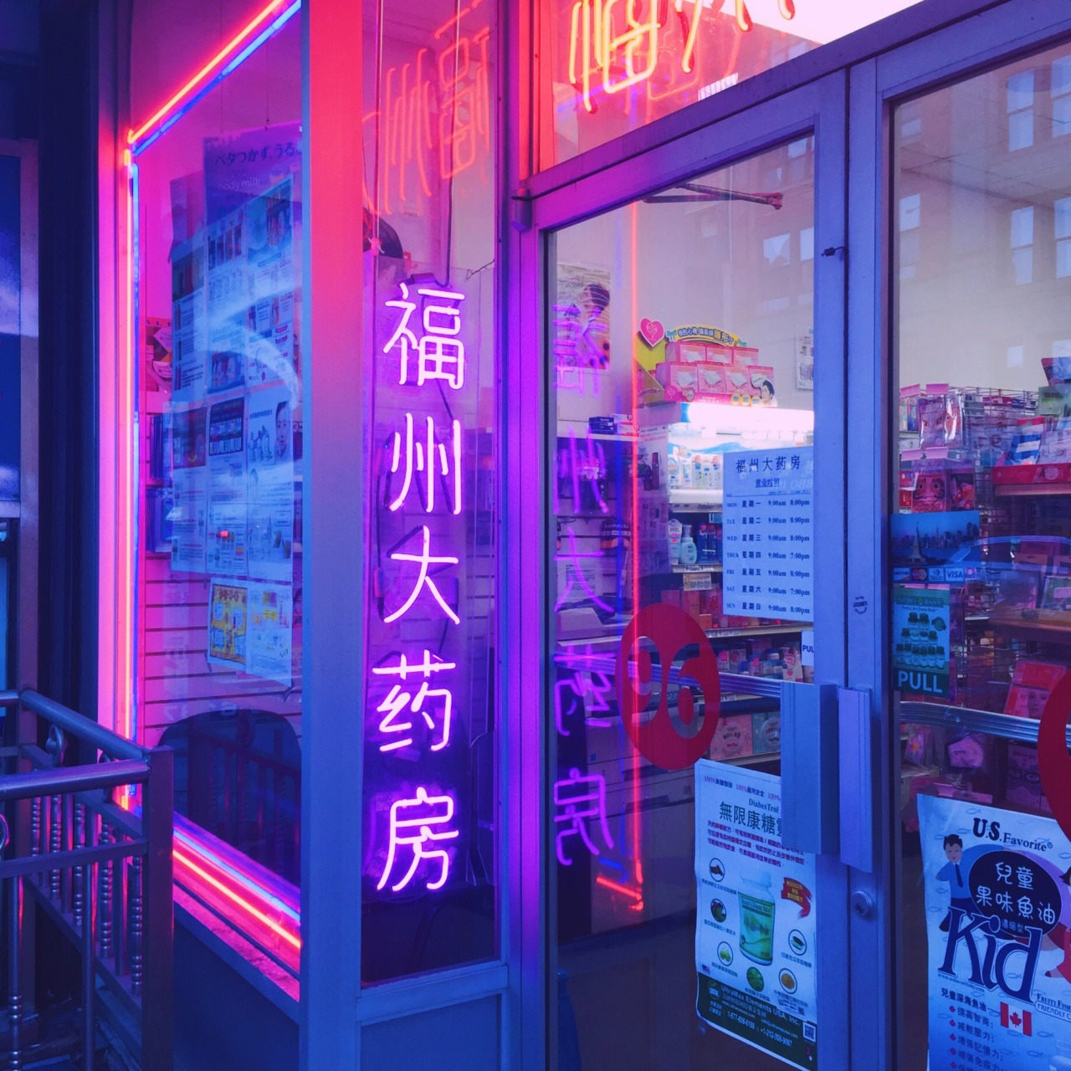
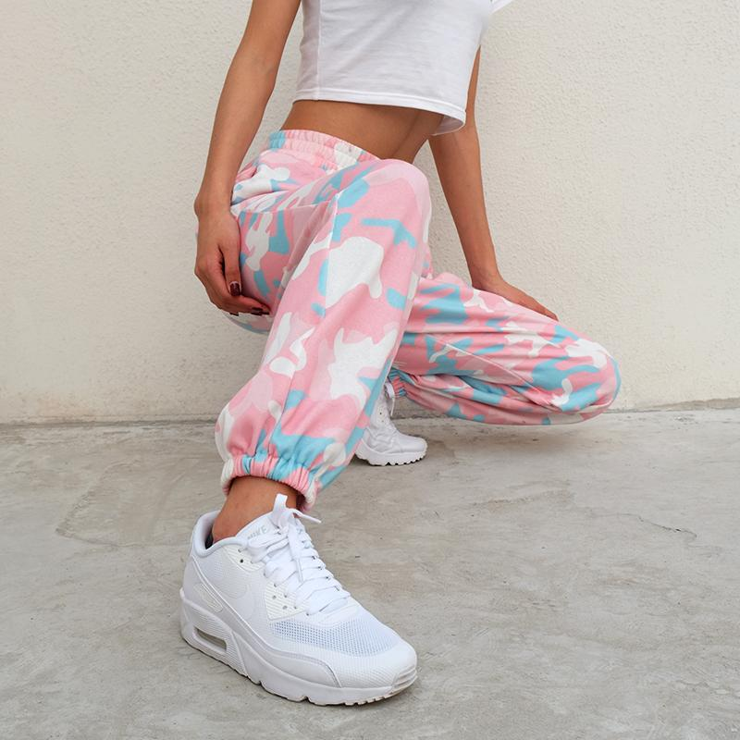
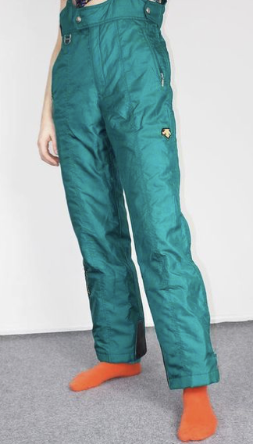
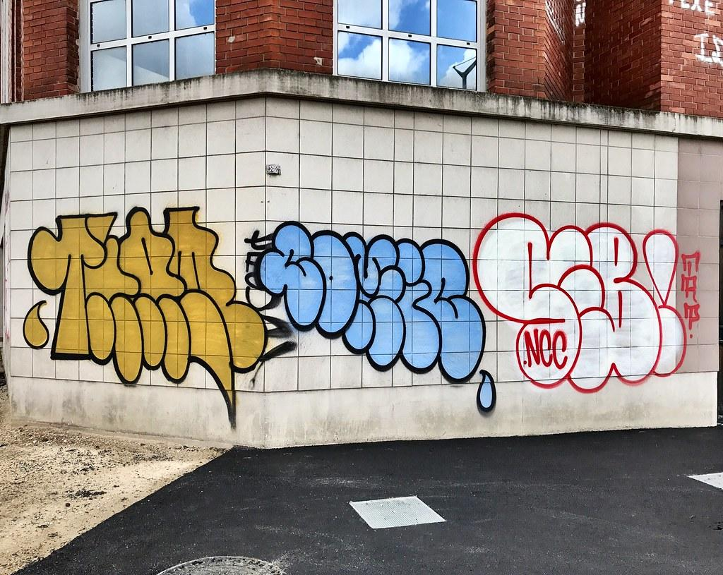
BRAND PROFILEl
Trendy, on-the-go, active, independent, working women. Her inspirations include Ivy Park, Adidas, and Urban Outfitters, and style icons like Kim K and Beyonce. Her style is motivated by the LA streets and New York City life. She loves lighter and brighter colors, and making a fashion statement everyday.
Our benchmark brand is Pacsun, while our aspirational brand is Obey.
Product Development Process
  Ideas and Research
  Line Conceptualization - 3 weeks
  Pre-Production - 3 weeks
  Sourcing - 2 weeks
  Production - 4 weeks
  Distribution - 2 weeks
Notes:
The well-known store Pacsun has a brand of their own named “Pacsun.” It is exclusively sold in PacSun stores. Obey is a streetwear company, frequently worn by celebrities and influencers. Gathering ideas by analyzing competitor garments and observing your target consumer, as well as researching retail environment information, should take us about 2-3 weeks. Line conceptualization includes sketching and choosing fabrics and colors for the line. During the pre-production process, sewn samples are produced, spec packs are created, fabric and trims are evaluated and tested, patterns are made along with the final approval of the markers. Before sending spec sheets to vendors, make sure that spec sheets are double checked for accuracy along with all other information being sent to the vendor. Once production is complete, garment should be tested for defects, then distributed to market.

Slide 4
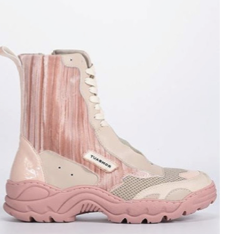
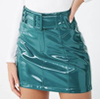
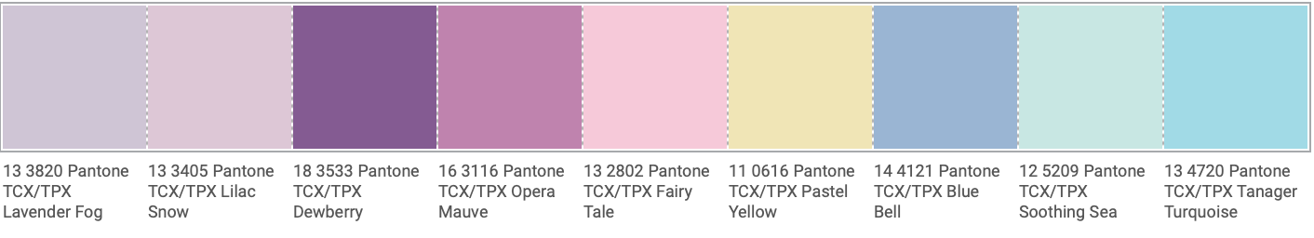

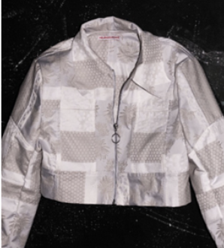
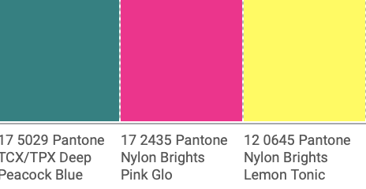
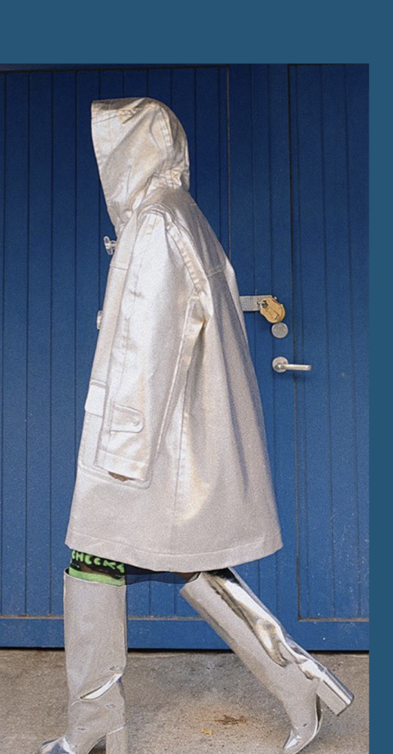
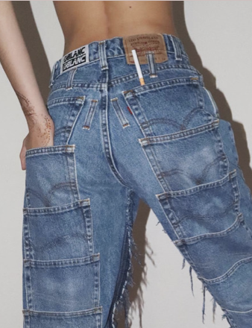
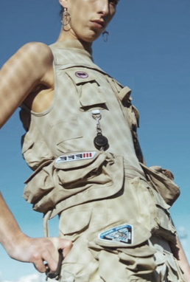

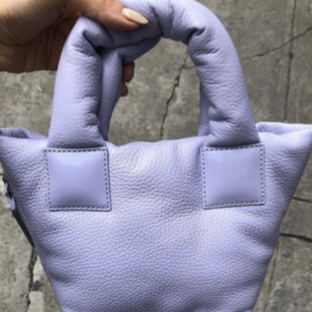
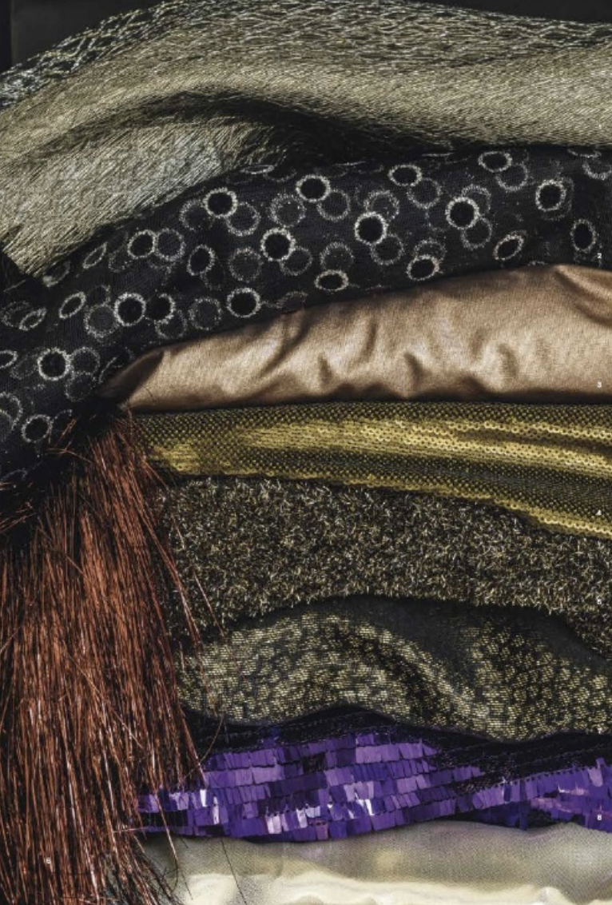
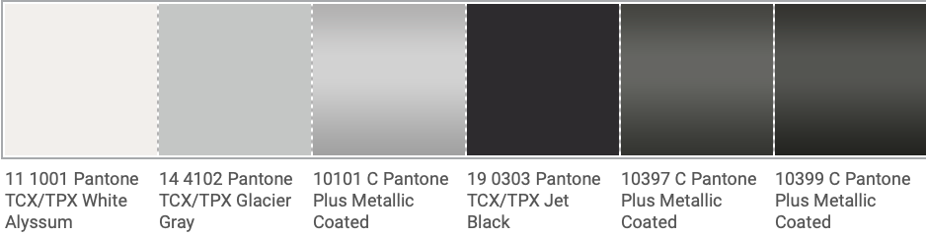
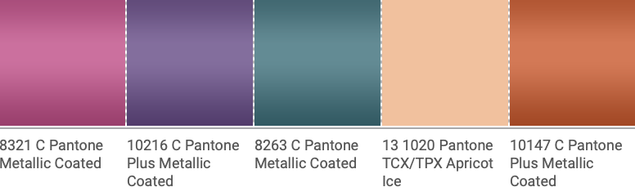
INSPIRATION AND LINE DIRECTION
Opulate Metallics
Lively
Lilac
Power
Purple
Tactful
Turquoise
Lavish
Lavender
Moody
Mauve
Precious
Pink
Bashful
Blue
Sea
Foam
Sunny
Glow
Puffed forms
Light reflecting fabrics
80s Comeback
Extreme hybrid utility
White
Whisper
Galvanizing
Gray
Galactic
Gray
Baffling
Black
Malefic Metallic Black
Mystic
Metal
Metallic
Mauve
Passionate
Purple
Testy
Teal
Active
Apricot
Off-Beat
Orange
Notes:
light reflecting fabrics
Even in lingerie, light reflecting fabrics and silver finishes give a techy feel
extreme hybrid utility
Takes the utility trend to its extremes, over-complicated, almost unnecessary amount decorative elements, dad sneaker and combat boot mash ups/hybrids
Puffed Forms
Obscure silhouettes, puffed prints, and quilted patterns define this trend perfectly. Padding and volume is a trend that is predicted to continue.
Colors
Both natural and saturated colors are in this Fall. Natural browns and reds, to light blues and greens, there is a good versatile range of colors to play with.
Lustrous eco viscose, silk, mercerized cotton,polyester, high stretch yarn, cellophane tapes, floss yarns, metallic polyesters, pearlised polyamide filaments, sparkling chenilles
Look
Power shoulders, 80s comeback, oversized tailoring, boxy heeled boots, python box bag, opulate metallics (sequins, lustrous silk, ect.),

Slide 5
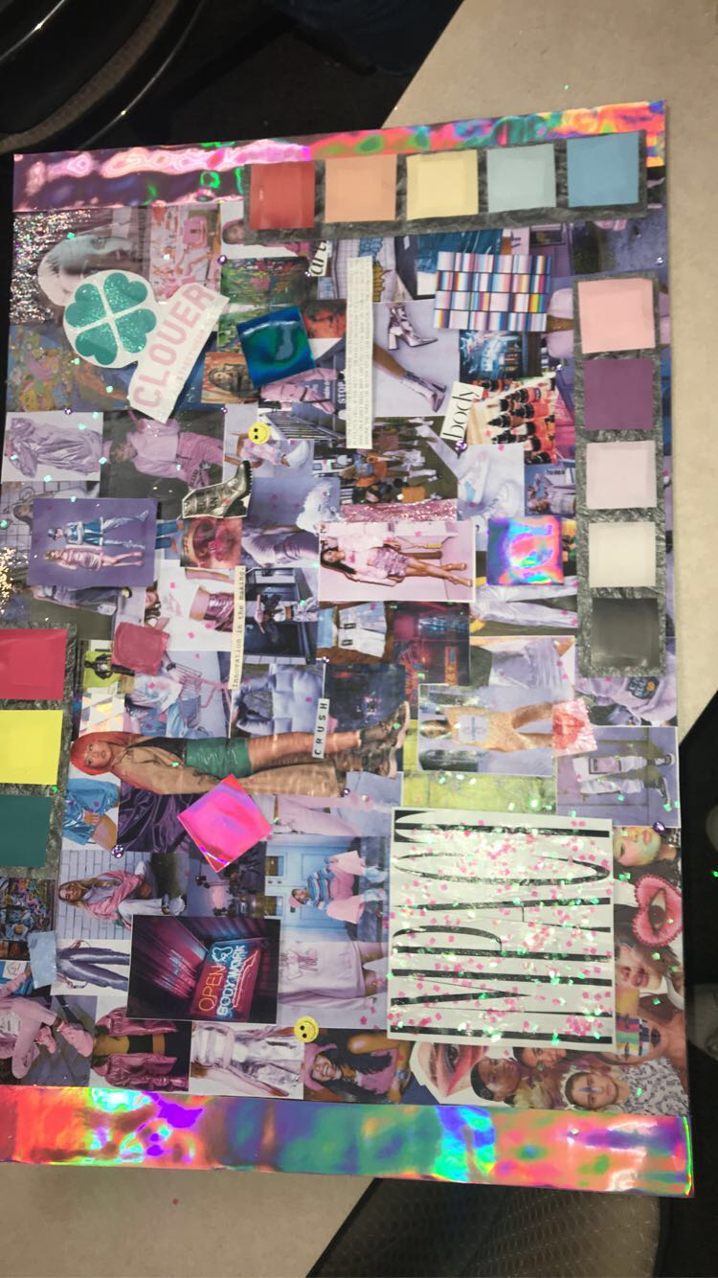



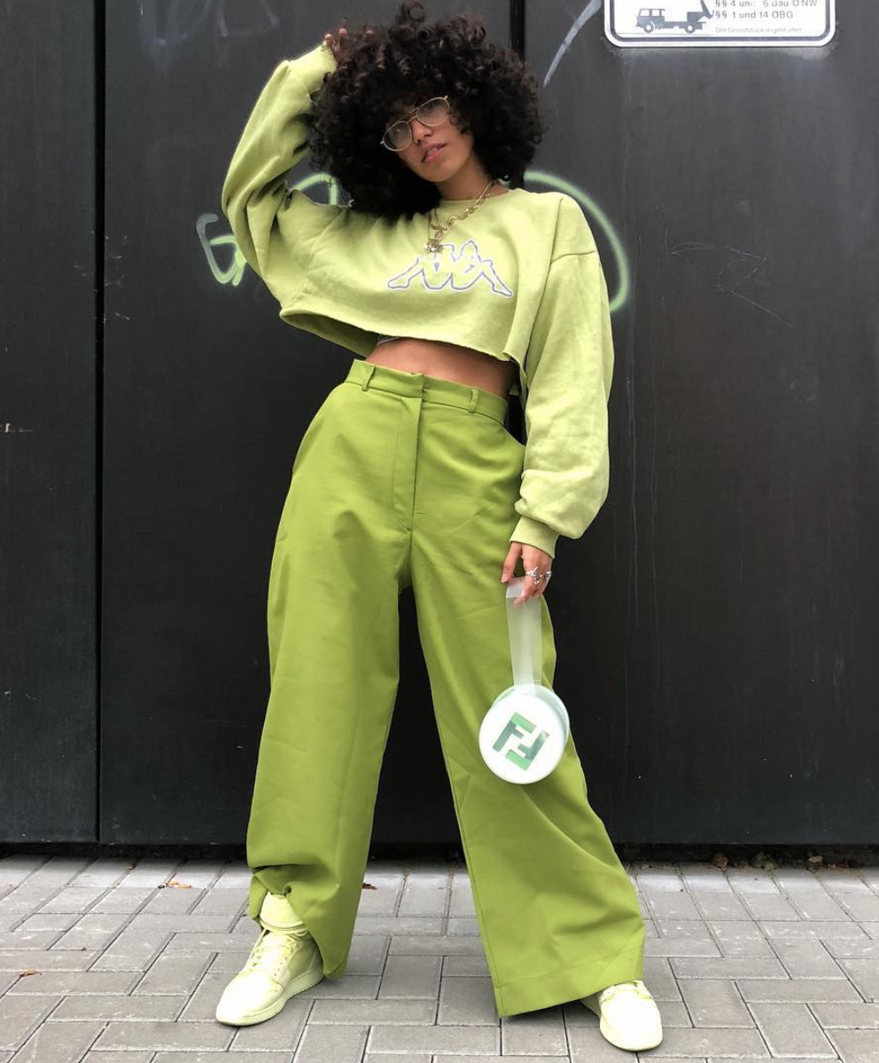

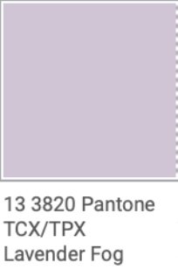
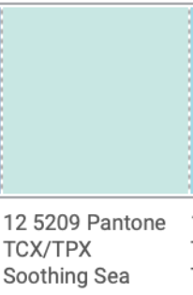
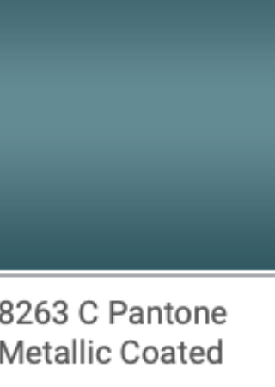
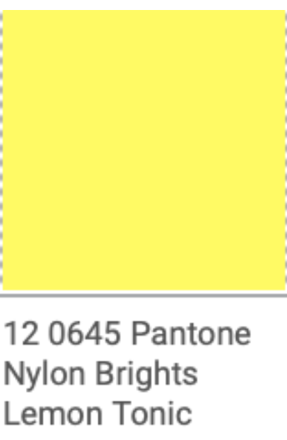
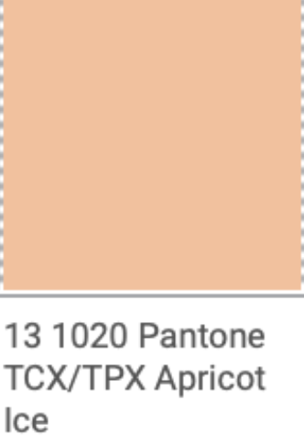
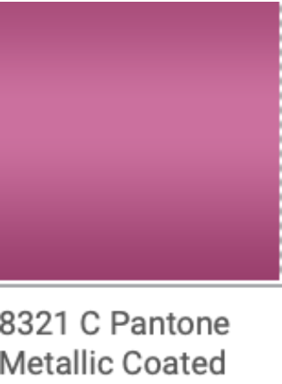
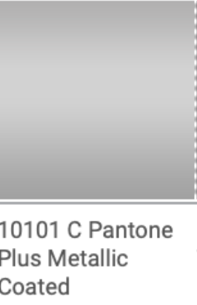
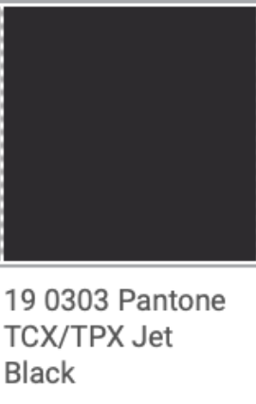
CONCEPT BOARD:
CLOVER
SS21
Lavish
Lavender
Sea
Foam
Testy
Teal
Lemon
Drop
Yellow
Active
Apricot
Metallic
Mauve
Baffling Black
Galactic
Gray
Notes:
Lavish Lavender, Sea Foam, Testy Teal, Lemon Drop Yellow, Active Apricot, Metallic Mauve, Galactic Gray, Baffling Black

Slide 6
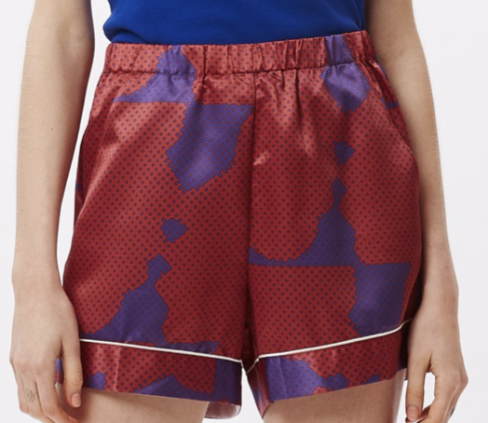
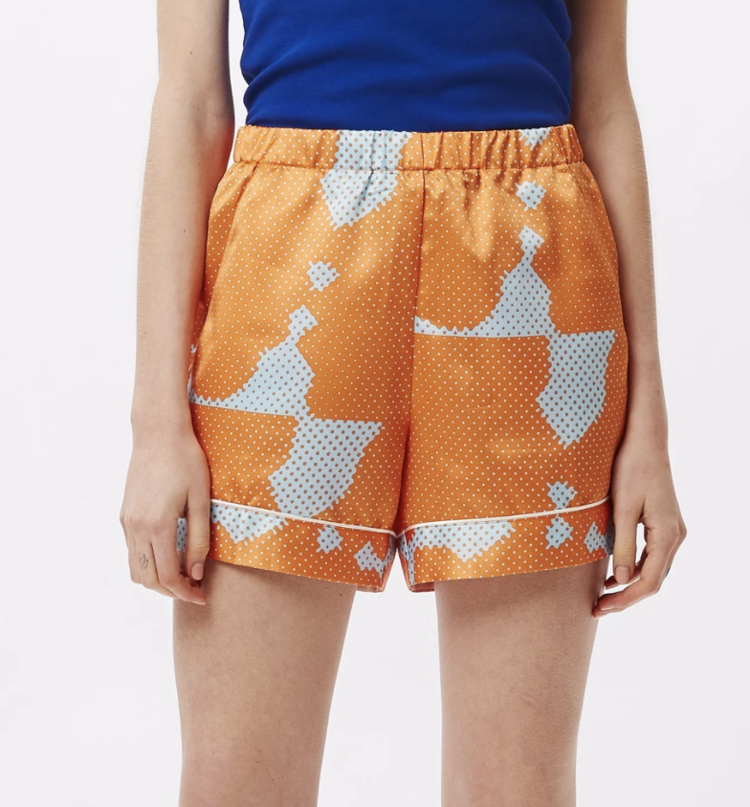
ANALYSIS OF KNOCK-OFF GARMENT
OBEY MAKEOUT SHORT
Style#: 272120071
Division: Women’s
Size Category: Regular, Plus Size
Size Range: xxs, xs, s, m, l, xl, xxl, xxl
Sample Size: m
Season: current
Estimate: $11.96
Description: sport shorts
Merchandiser/Designer/Technical Designer:
Jane Doe
Brand: Obey
Fabric: 100%, woven, satin
Colors: red and blue, light blue and orange
Create Date: 2/21/20
Modified: yes
Due Date:
Ship Date: 3/1/21
Vendor: woopity dooda
ELASTIC WAIST BOXER SHORT WITH CONTRAST PIPING DETAILS
COMES IN A CUSTOM OBEY PRINT ON SHINY SATIN FABRIC
RISE: 12 ; LEG OPENING: 25
INSEAM: 4 1/2
100% POLYESTER
SKU: 272120071
MODEL IS 5 FT 5 IN TALL AND
WEARING A SIZE SMALL
$59 Obeyclothing.com
Target Market? Trendy teens with a large amount of disposable income
Notes:
Demographics: Women, 18-30 yrs, trendy, fast-paced lifestyle, urban areas, upbeat, young adults with disposable income
Why we chose Obey?
What we would update in our own brand? We will use a cheaper polyester to create a cheaper satin, as well as making less claims on the garment, as it is not actually used for active wear, just fashion. We will make a smaller profit off each garment as well, to make the product cheaper for our consumers.
SWOT

Slide 7

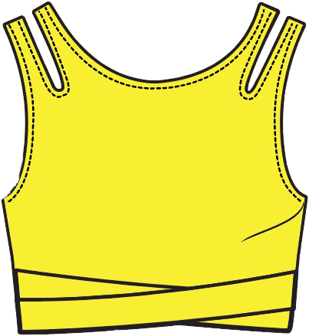
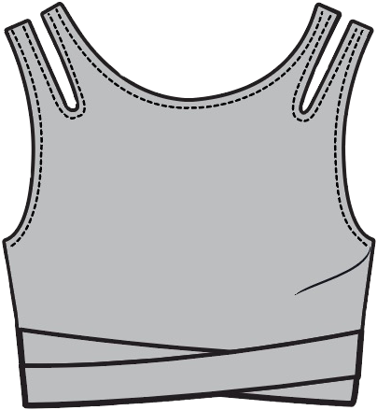
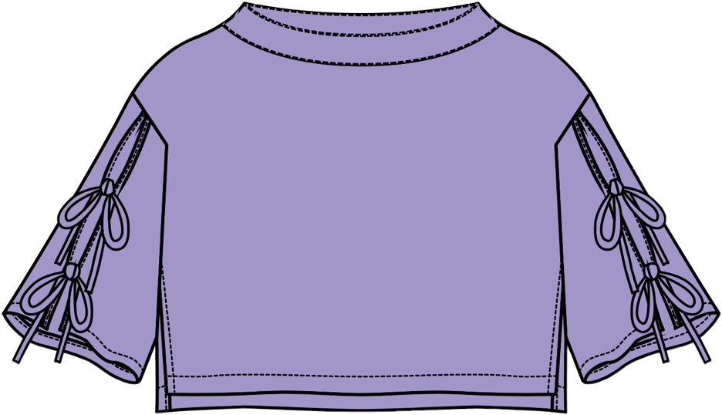
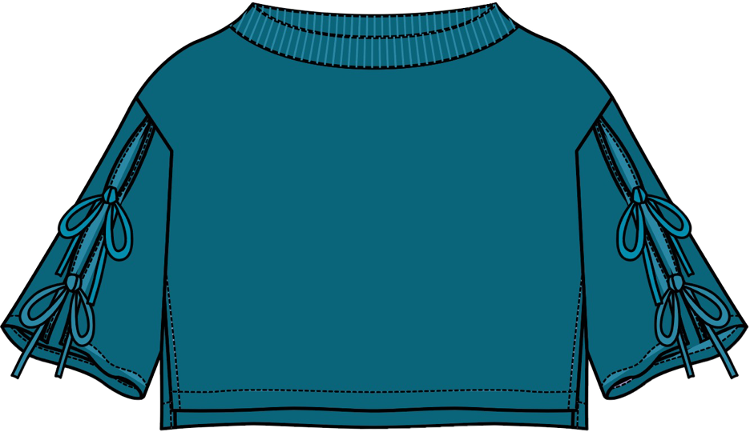
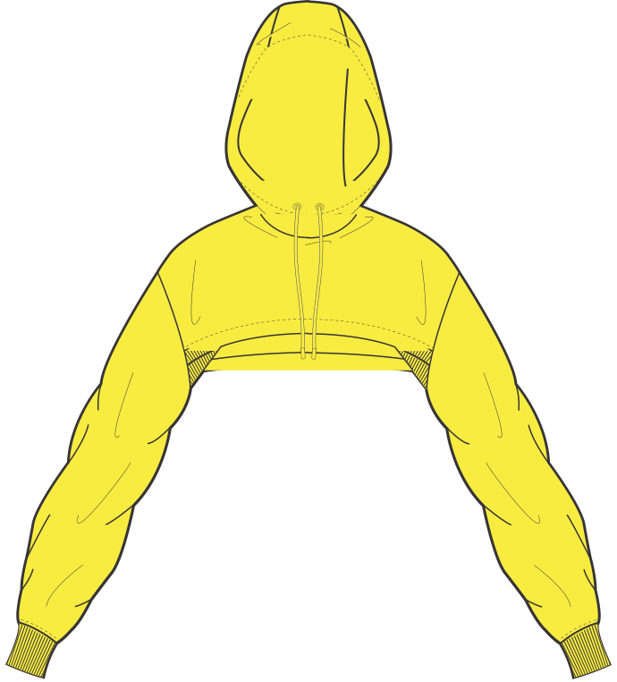
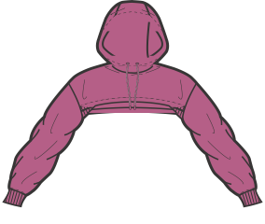
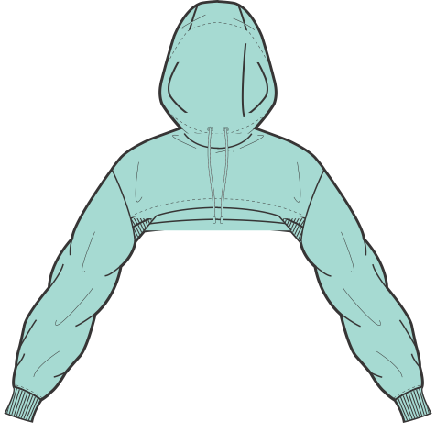
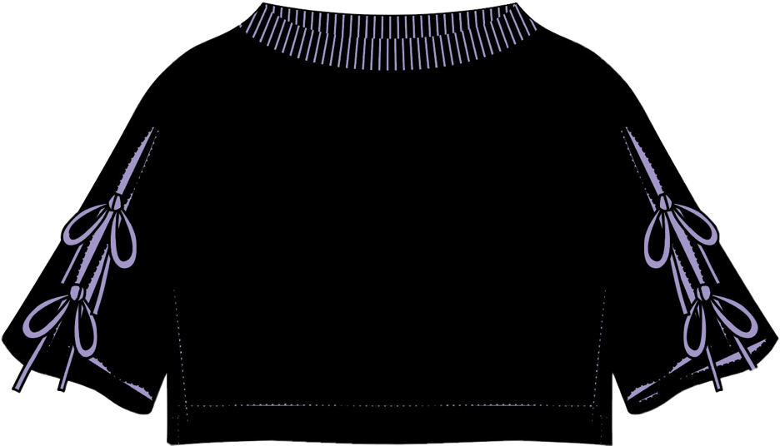
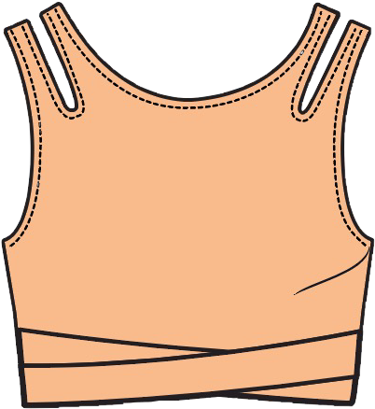
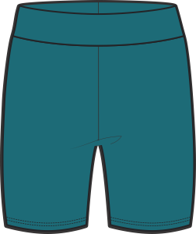
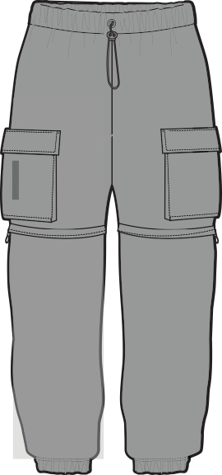
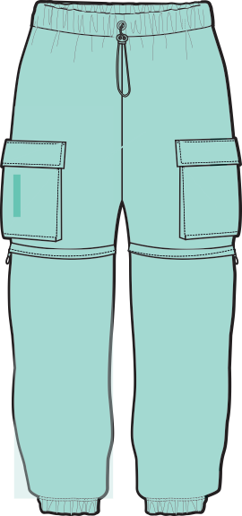
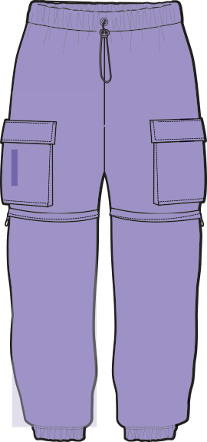
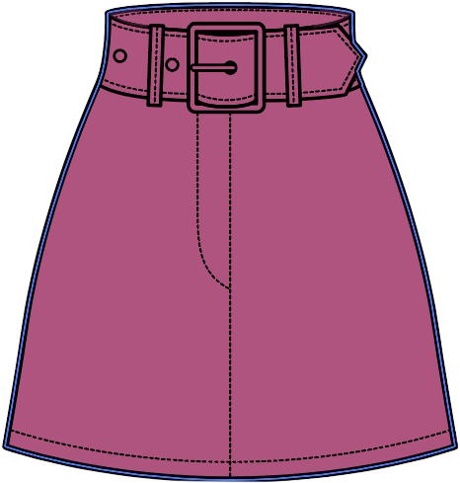
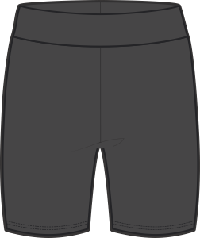
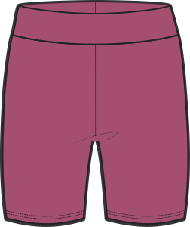
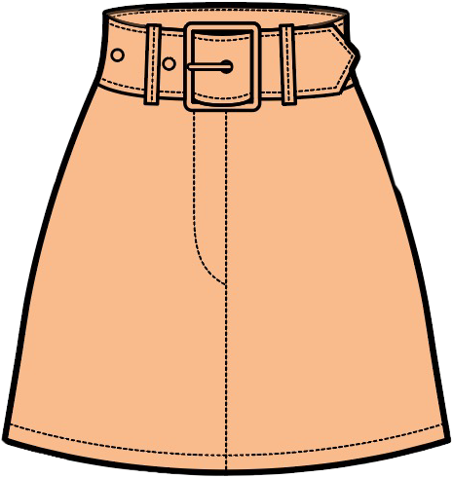

CLOVER Spring/Summer 2020
The Runaway collection
Notes:
How each garment can pair with one another and stand alone.

Slide 8
All Free Cropped Hoodie
Features
  Drawstring hoodie
  Cropped length
  Synched at the wrist
Fiber Content
  100% Cotton
  Woven
  Fleece Fabric
Suggested Retail price
  $ 39.00
Care Instructions
  Wash with like colors
  Machine wash cold
  Tumble dry low
Notes:
Notes about what this can be paired with and how it can be versatile.
The All Free Cropped hoodie is a relaxed fit can be paired with our All Day high waisted biker shorts
Easily be ranged from airport casual to NYC cool

Slide 9

All Day Biker Short
Features
  High-rise waist
  Mid thigh length
Fiber Content
  81% Nylon, 19% Lycra
  Woven
  Nulux Fabric
Suggested Retail Price
  $59.00
Care Instructions
  Wash with like colors
  Machine wash cold
  Tumble dry low
Notes:
The All Day Biker Short is a classic, with full support and coverage
Perfectly paired with our All Free Cropped Hoodie for those days you want to be trendy but comfortable
Easily can be worn with an oversized tee and cap for a casual look

Slide 10
The Everyday Jogger
Features
  Elasticized waist and hem
  Snap button cargo pockets
  High-rise waist
Fiber Content
  100% Cotton
  Woven
  Nylon/Lycra Fabric
Retail Price
  $79.00
Care Instructions
  Machine wash cold
Notes:
Notes about what this can be paired with and how it can be versatile.
The Everyday Jogger feature cargo flap pockets, a high-rise waist, and a comfortable everyday fit
Can be paired with our All Free Cropped Hoodie or The Cut It Tank and chunky sneakers for a blogger worthy look

Slide 11

Buckle Up Mini Skirt
Features
  Belted mini skirt
  Removable belt
  A-line silhouette
Fiber Content
  100% Cotton
  Woven
  Denim
Suggested Retail Price
  $65.00
Care Instructions
  Wash with like colors
  Machine wash cold
  Tumble dry low
Notes:
Notes about what this can be paired with and how it can be versatile.
Our Buckle Up Mini Skirt can be worn during the day and for a night out

Slide 12

Tie It Up Crop Top
Features
  Cropped length
  Double bow tie string split mid length sleeve
  Ribbed trim neckline
  Side cut outs
Fiber Content
  100% Cotton
  Woven
  Cotton Fabric
Suggested Retail Price
  $40.00
Care instructions
  Wash with like colors
  MAchine wash cold
  Tumble dry low
Notes:
Notes about what it can be paired with:
This cropped shirt can be paired with the joggers and biker shorts for a casual look
Can be paired to dress up with the skirt

Slide 13

The Cut it Tank
Features
  Stretch to fit
  Cut out straps
  Cross Wrapped trimming
Fiber Content
  95% Polyester, 5% Spandex
  Woven
  Lycra Fabric
Suggested Retail Price
  $30.00
Care instructions
  Wash with like colors
  Machine wash cold
  Tumble dry low
Notes:
Show off your shape with this wrapped, cut tank
Team this tank with our All Day Biker Shorts for a effortlessly fit

Slide 14

CLOVER
The Runaway Collection
Spring/Summer
2021
Notes:
“And that concludes our sales presentation. We hope you will consider purchasing this new line”

